Slide 1
AIRE Module Documentation

Slide 2
generate_intake_forms module
Generates intake forms based on an operational plan and intake form template

Slide 3
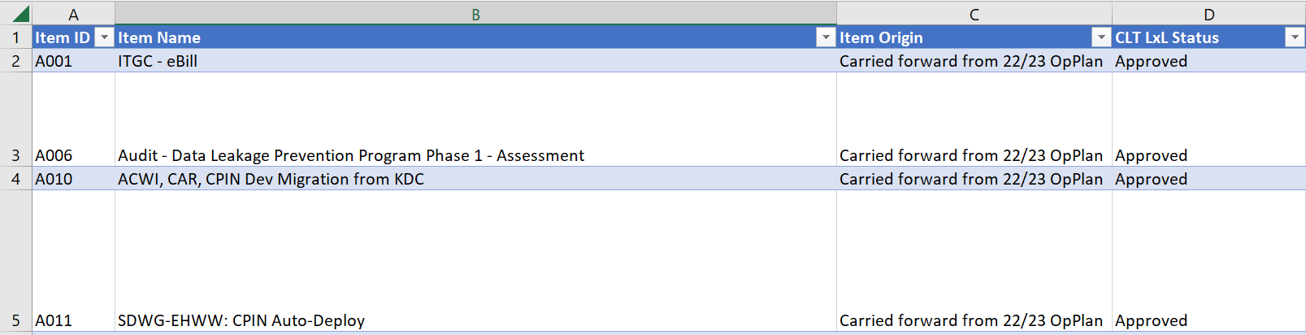
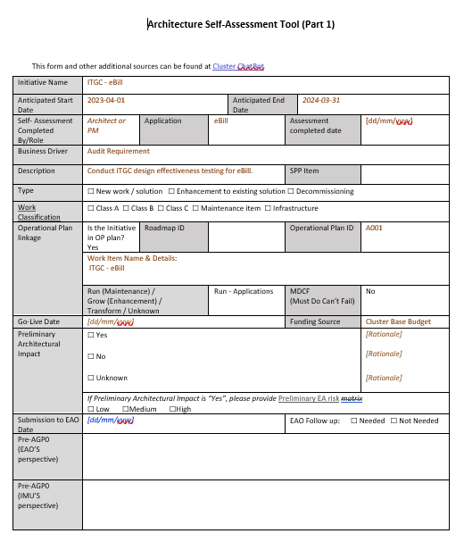
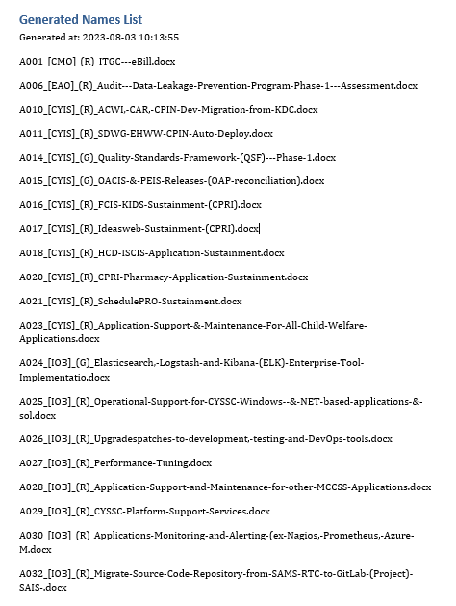
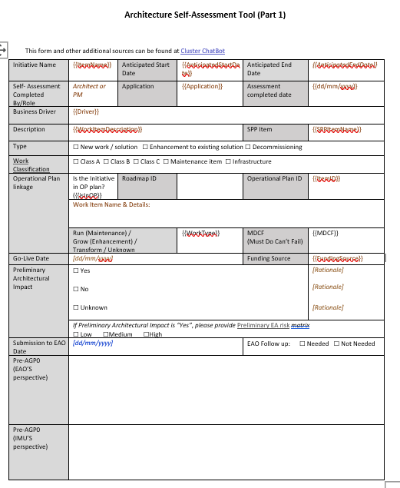
Module details
Input Files
Output Files
Operational plan
Intake forms (over 100)
Intake form names list
AIRE
Intake form template

Slide 4
compare_operational_plans
Compare operational plans if an operational plan gets updated

Slide 5
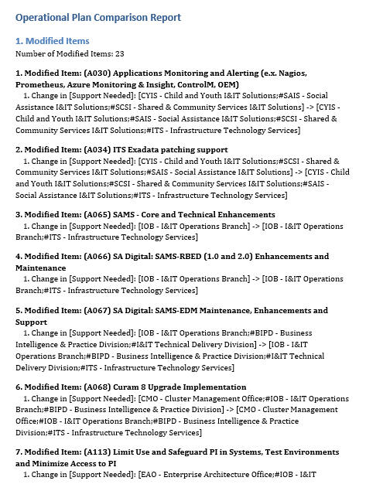
Module details
Input Files
Output Files
New Operational plan
Operational plan comparison report
AIRE
Old Operational plan

Slide 6
generate_risk_assessment_report module
Generates a comprehensive risk assessment report based on rubrics and submitted risk assessment

Slide 7
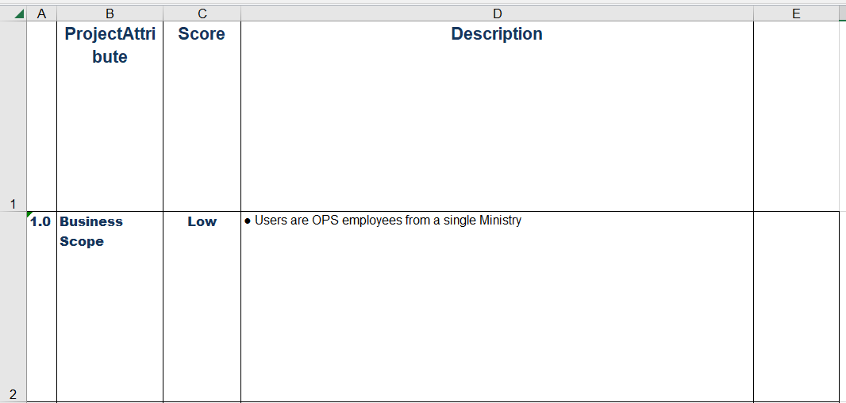
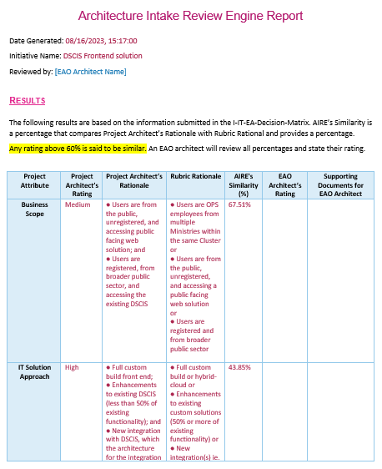
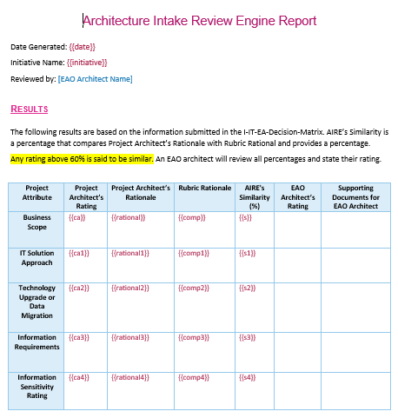
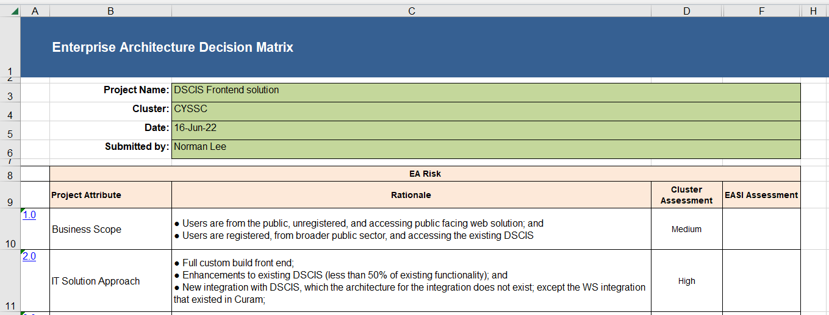
Module details
Input Files
Output Files
Rubrics
Report
Report template
AIRE
Self risk assessment

Slide 8
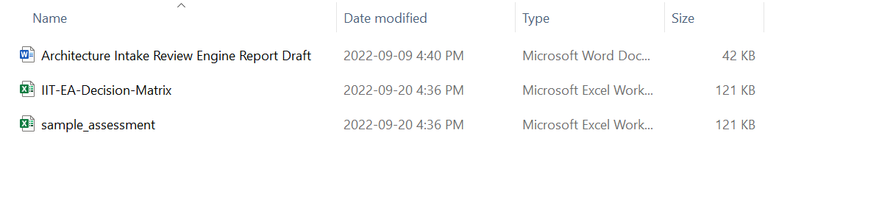
Input files
Directory: data/input/pre_agp0
Architecture Intake Review Engine Report Draft: Base Template. Text extracted from ‘IIT-EA-Decision Matrix’ and ‘sample_assessment’ is inserted here.
IIT-EA-Decision-Matrix: An Excel file that has rubrics
Sample_assessment: A sample risk assessment file submitted by a solution branch. Used for testing purpose.

Slide 9
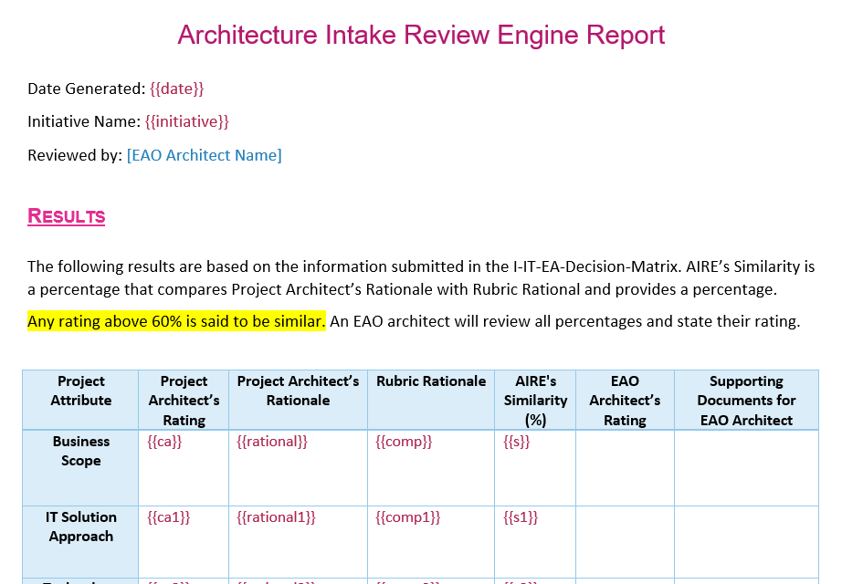
Architecture Intake Review Engine Report Draft
Architecture Intake Review Engine Report Draft: Base Template. Text extracted from ‘IIT-EA-Decision Matrix’ and ‘sample_assessment’ is inserted here
Text extracted from ‘IIT-EA-Decision Matrix’ and ‘sample_assessment’ is inserted here

Slide 10
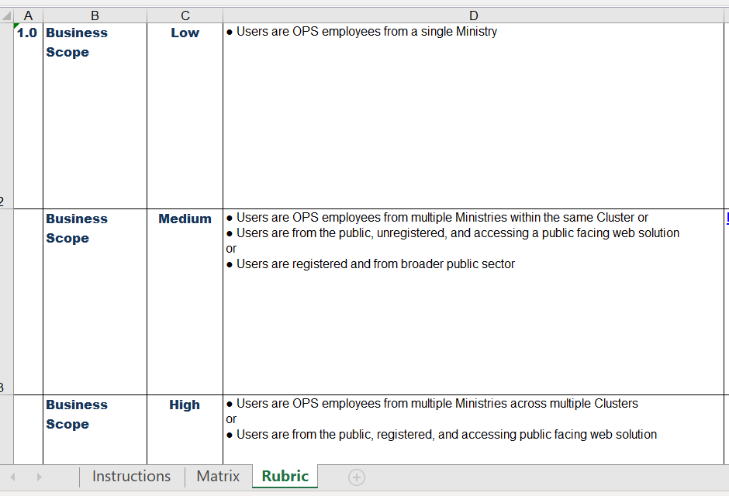
IIT-EA-Decision-Matrix
IIT-EA-Decision-Matrix: an Excel file that has rubrics. Go to the ‘Rubric’ sheet to see the rubrics.
There are 5 attributes: Business Scope, IT Solution Approach, Technology Update and/or Data Migration, Information Requirements, Information Sensitivity Rating
There are 3 risk ratings for each categories: Low, Medium, High
v
Rubric rationale for Business Scope attribute’s low risk rating
Rubric rationale for Business Scope attribute’s low risk rating
Rubric rationale for Business Scope attribute’s low risk rating
‘Rubric’ sheet

Slide 11
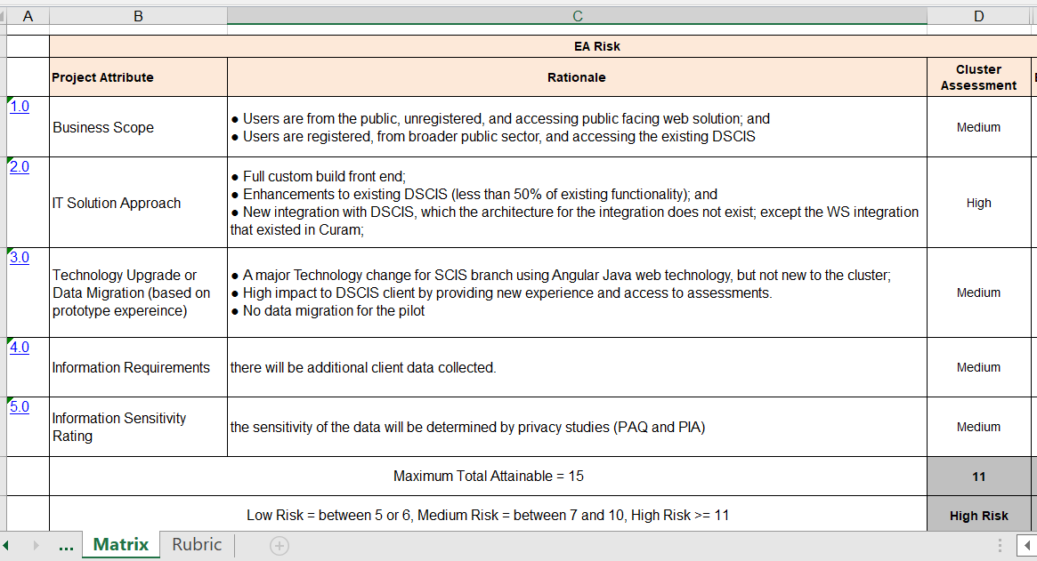
Sample_assessment
Sample_assessment: a sample risk assessment file submitted by a solution branch. used for testing
Go to the ‘Matrix’ sheet to see the risk assessment. Text in this sheet is extracted to be inserted into the template
Rubric rationale for Business Scope attribute’s ‘Medium’ risk rating
Risk of the Business Scope attribute of this project is rated as ‘Medium’
Total risk score
Comprehensive risk rating
‘Matrix’ sheet

Slide 12
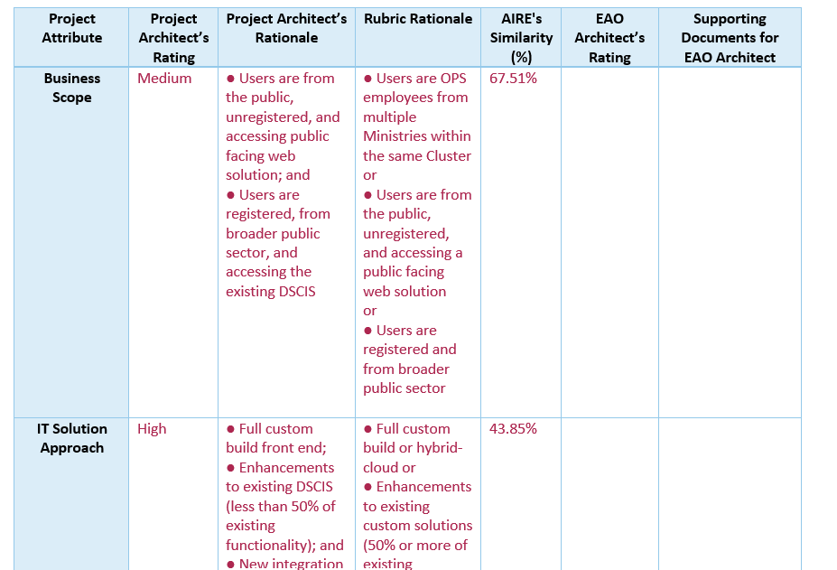
Final Output – Assessment_Report.docx
‘Architecture Intake Review Engine Report Draft’ is filled with text extracted from ‘IIT-EA-Decision-Matrix’ and ‘Sample_assessment’. And also, similarity ratio of submitted rationale and rubric rationale calculated by an algorithm.
Text extracted from ‘IIT-EA-Decision-Matrix’
Text extracted from ‘Sample_assessment’
Similarity ratio

Slide 13
How to fill in
Prepare a dictionary that has all key required in the template and values for each key
context = {
'date': get_today_date_time(),
'initiative': initiative_name,
'score': risk_score, …
}
2. Render the dictionary to the template
doc.render(context)

Slide 14
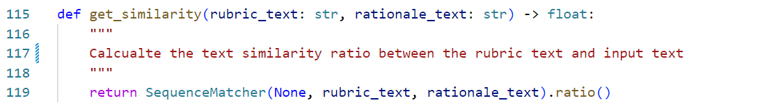
Calculating Text Similarity
get_similarity function calculates the similarity ratio of submitted rationale and rubric rationale.
Currently, SequenceMatcher(compares pairs of sequences) is used for similarity calculation algorithm.
The accuracy of similarity can be improved by replacing SequenceMatcher with a deep learning NLP model.

Slide 15
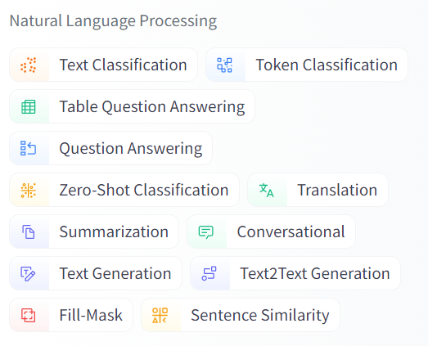
NLP model
There are lots of open source NLP models and they can be found in several websites.
For example, https://huggingface.co/models
Or other websites.
NLP Models can be found below ‘Natural Language Processing’ category at the left bar at the link above.

Slide 16
check_agp0_submission
Check if an AGP0 submission has all the requirements

Slide 17

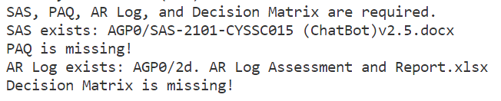
Module details
Input Files
Output Files
AGP0 Submission
Check result (CLI)
AIRE
* AGP submissions are in this folder
01 - APPL

